Slide 1
Data Science Engineering Methods and Tools Lecture 10
Northeastern University
College of Engineering
INFO 6105 – Spring 2024
Abdolreza Mosaddegh

Slide 2
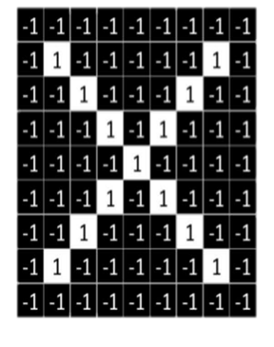
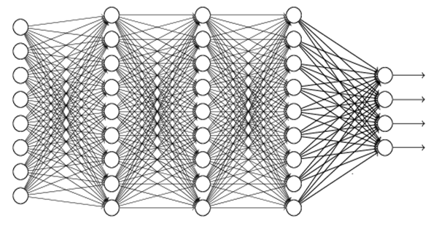
Classification of Images
For classification of images the pixels can be used as inputs.
98% X
1% Y
…
We want to be able to classify an X in handwriting

Slide 3
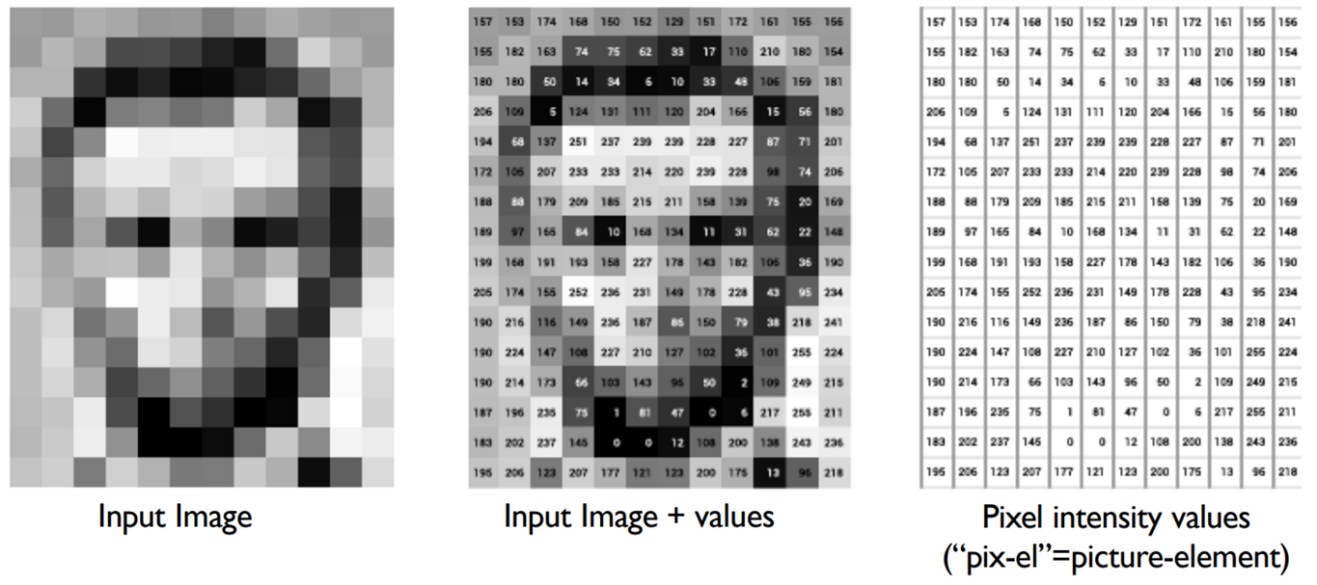
Pixels as Inputs
Each grayscale pixel represented by 1 value, usually between 0 to 255
Where 0 is black, 255 is white, and values in between are shades of gray
Since each grayscale pixel represented by 1 value, we say channel size is 1, for RGB color pictures the channel size is 3

Slide 4
Limitations of Fully Connected Layers
If input is 64 pixel by 64 pixel RGB image, represented by:
64 x 64 x 3 = 12,288 values (inputs)
Hence, input layer of a Neural Network has 12,288 nodes
Assume that next layer has 8,000 nodes (near 2/3 of input layer)
Suppose that this neural network is fully connected, then we have 12,288 * 8,000 = 98,304,000 weights (parameters to be learnt during training)
Usually, we need more layers for extracting complex features
Having too many weights:
Makes learning more difficult as dimension of feature space is increased (curse of dimensionality)
Increases the likelihood of overfitting
Makes training more time/resource consuming

Slide 5

Other Limitations of Fully Connected Layers
Some patterns are much smaller than the whole image
Only a subset of inputs are required for recognition of these patterns
Fully connected layers (Dense) connects all nodes to all nodes in the next layer to create results

Slide 6

Convolutional layers are specifically tailored for image and video processing tasks: - Convolutions (filters) detect specific patterns inside the image - Same pattern appears in different places of images; therefore, the pattern detector should cover different parts of the input image
Convolutional Layers
middle beak
upper-left beak

Slide 7

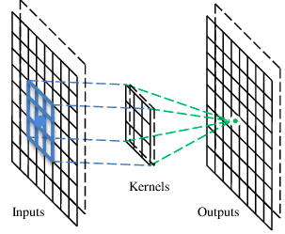
Filter (Convolution)
Each filter extracts a specific feature (pattern) from different sections of an input layer.
A filter is a set of connections (with weights) between nodes from two subsequent layers.
By applying each filter to an input, an output (feature map) is created which represents presence or absence of a specific feature.
Beak detector
A filter
Convolution Feature Map

Slide 8
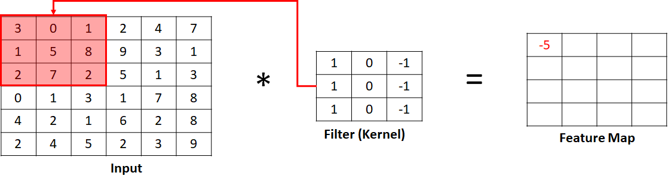
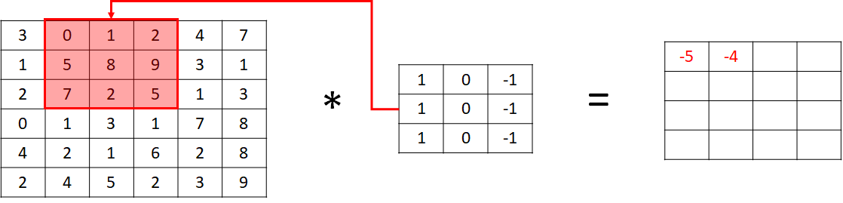
Convolution Operation
Since convolutional layers are not fully connected each filter relates a set of neurons in input layer to a set of neuron in the output layer, therefore the convolution operation is element wise (despite matrix dot operations in dense layers)
3x3 filter (or kernel)
3*1 + 0*0 + 1*-1 + 1*0 + 5*0 + 8*-1 + 2*1 + 7*0 + 2*-1 = -5
0*1 + 1*0 + 2*-1 + 5*1 + 8*0 + 9*-1 + 7*1 + 2*0 + 5*-1 = -4

Slide 9
Pattern Detection
Higher value indicates more probability of presence of a pattern
Indicates high probability of presence of the pattern
0=blank, 1= point
3
-1
-3
-1
1 | 0 | 0 | 0 | 0 | 1
0 | 1 | 0 | 0 | 1 | 0
0 | 0 | 1 | 1 | 0 | 0
1 | 0 | 0 | 0 | 1 | 0
0 | 1 | 0 | 0 | 1 | 0
0 | 0 | 1 | 0 | 1 | 0
1 for presence of a point in a right place and -1 for presence of a point in wrong place
-3
1
0
-3
1 | -1 | -1
-1 | 1 | -1
-1 | -1 | 1
-3
-3
0
1
3
-2
-2
-1
6 x 6 image
3 x 3 filter
4 x 4 output

Slide 10
Multiple Filters
Several filters can be used to extract different features from each input
A convolutional layer has several filters
Multiple filters create multiple feature maps
Convolutional layer contains multiple feature maps
Each filter detects a small pattern (3 x 3)
3
-1
-3
-1
-1
-1
-1
-1
1 | -1 | -1
-1 | 1 | -1
-1 | -1 | 1
Filter 1
1 | 0 | 0 | 0 | 0 | 1
0 | 1 | 0 | 0 | 1 | 0
0 | 0 | 1 | 1 | 0 | 0
1 | 0 | 0 | 0 | 1 | 0
0 | 1 | 0 | 0 | 1 | 0
0 | 0 | 1 | 0 | 1 | 0
-3
1
0
-3
-1
-1
-2
1
Feature
Map
-3
-3
0
1
-1 | 1 | -1
-1 | 1 | -1
-1 | 1 | -1
-1
-1
-2
1
Filter 2
3
-2
-2
-1
-1
0
-4
3
6 x 6 image
……
Two 4 x 4 images

Slide 11
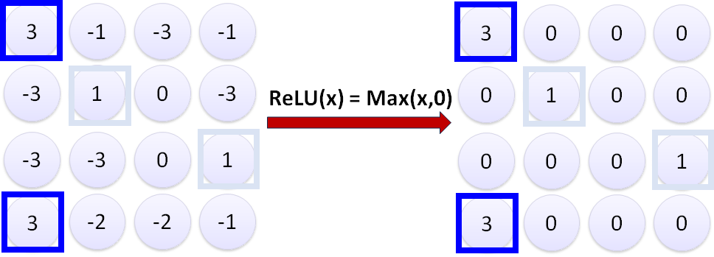
Activation Function
Preferred activation function in convolutional layers is ReLU
ReLU leaves outputs with positive values as is, replaces negative values with 0
ReLU deactivates nodes with less probability of having the pattern in the network and make it lighter
Apply activation function to output also provides non-linearity

Slide 12
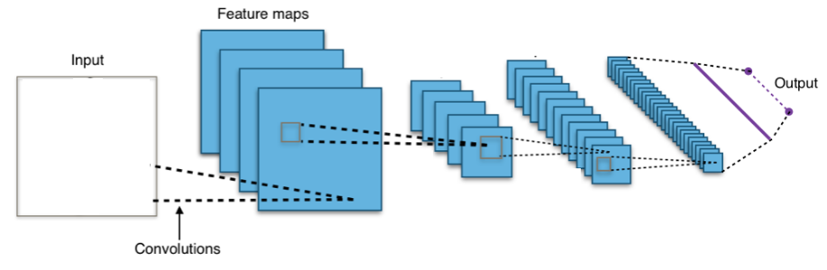
Convolutional Neural Network (CNN)
A CNN is a neural network which includes some convolutional layers.
A CNN is a more scalable approach to image classification comparing traditional object recognition techniques.
Convolutional
Layer

Slide 13
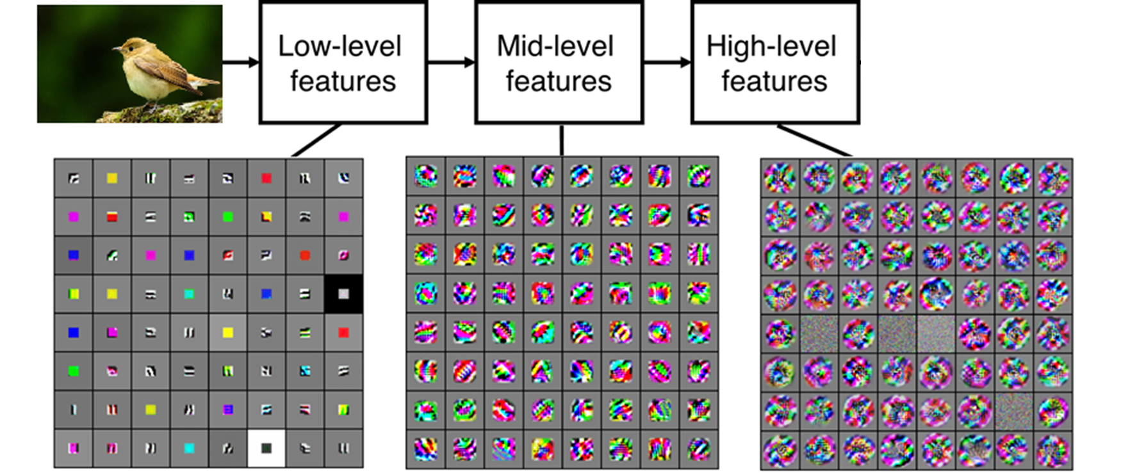
Feature Extraction in Multiple Layers
CNNs contains multiple convolutional layers
Each Layer contains multiple filters to extract different features
Multiple Layers of feature extraction are required to extract complex features by combining outputs from last layers
Edges, Rounds, ..
Beak, Belly, ..
Structures of Bird, Cat, Dog, ..

Slide 14
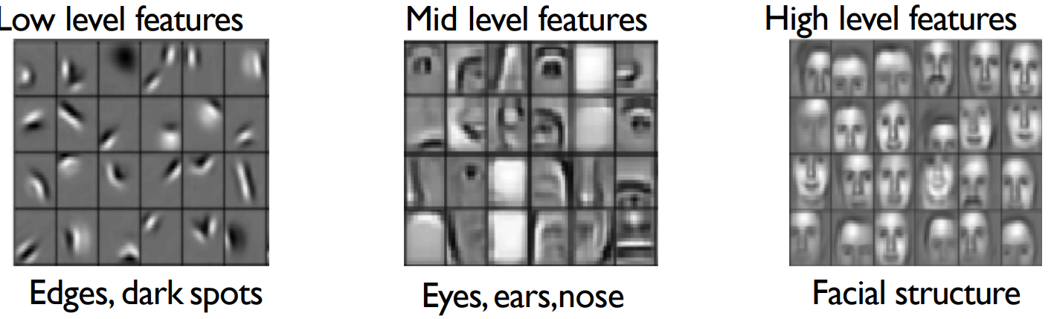
Layers of Feature Extraction - Example
Face recognition:

Slide 15
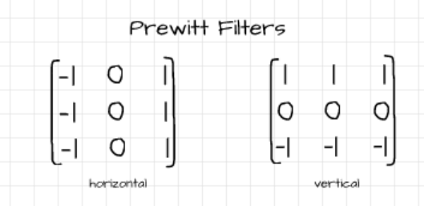
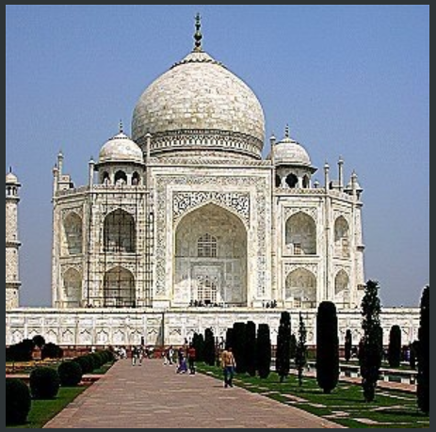
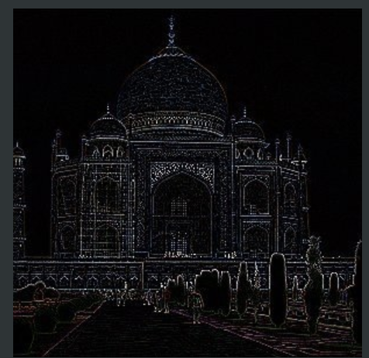
Patterns Detected by Various Filters
CNN can extract different patterns from the input data by using different filters.
For example, the Prewitt filters is comprised of two filters which help to detect vertical and horizontal edges.
These filters can extract low level features.

Slide 16
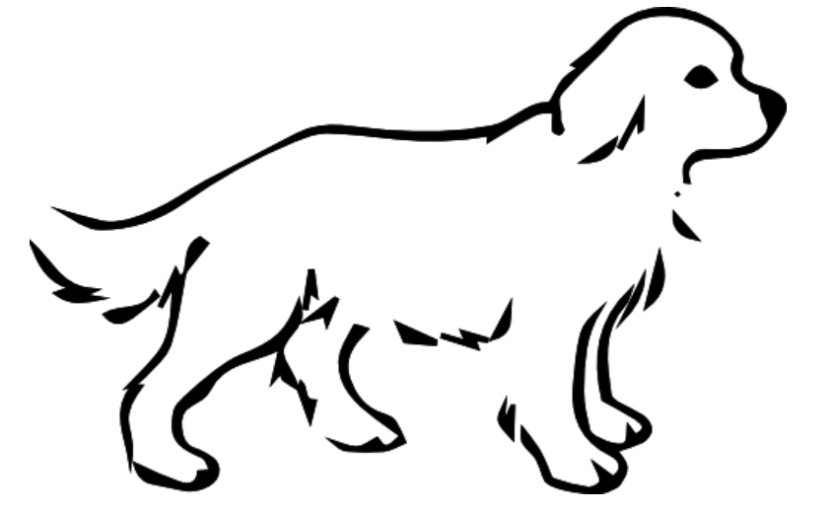
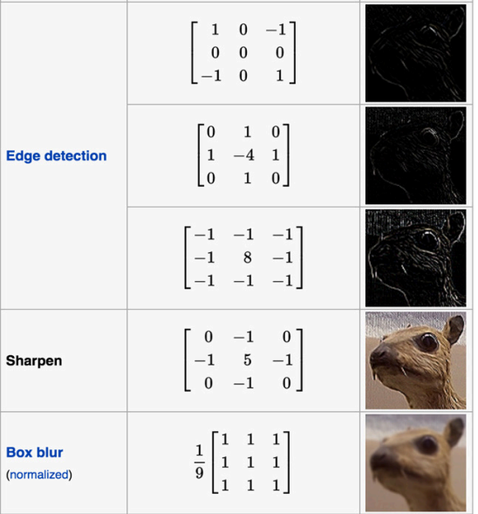
Edges
A lot of information of an object is contained in its edges (outlines).
It's one of the reasons why we can easily distinguish objects in cartoon sketches.
There are numerous studies to suggest that edge perception is one of the first techniques utilized by the human brain when processing visual cues coming from the eyes (Willian Mcllhagga, 2018)
Number of pixels (features) in outlines are much less than a whole picture

Slide 17
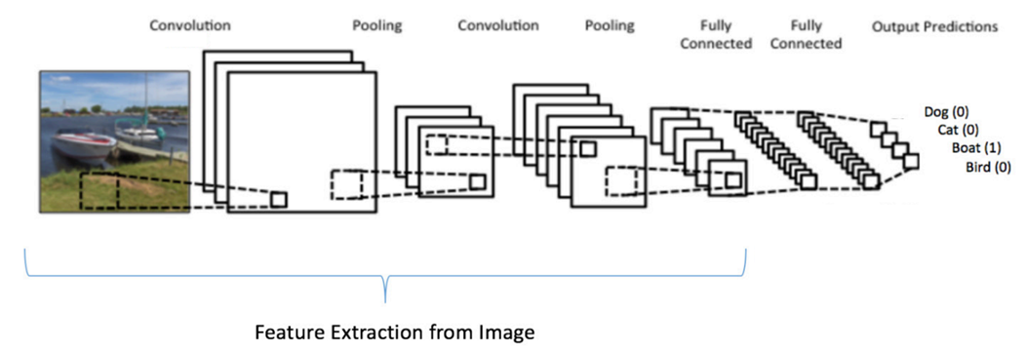
Embedded Feature Extraction
Filters are the weights between nodes (parameters) in convolutional layers.
Weight are adjusted during training (backpropagation) in a way that minimizes classification error.
Therefore, adjusting filter and extracting features is embedded in training of CNN replaced manual feature extraction techniques.

Slide 18

Classification by High-level Features
High-level features can be extracted by applying multiple convolutional layers
These high-level features are combinations of lower-level features and together represent a class of object
A classifier (e.g., a fully connected neural network) can assign a class (label) to these high-level features
Bird, Cat, Dog, ...
Edges, Rounds, ..
Beak, Belly, ..
Structures of Bird, Cat, Dog, ...

Slide 19
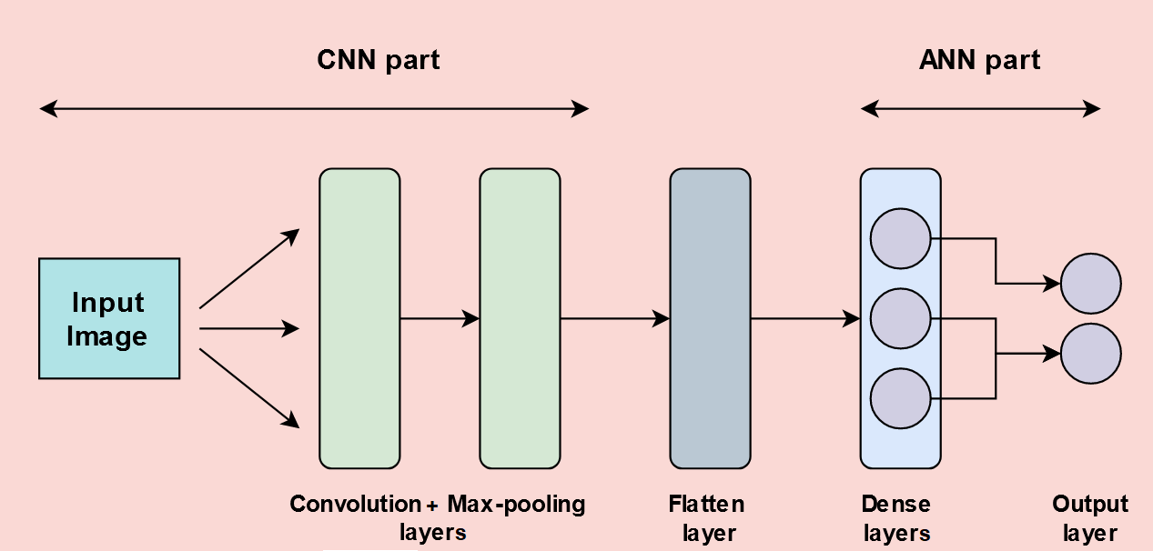
Classification in CNN
High-level features can be fed as input to a classifier (e.g., Fully connected Feed Forward NN) to classify objects.
Typically, a CNN model consists of convolution layers, for feature extraction, followed by fully connected layers that perform the classification task.
Out put from convolutional layers:
High signals on Bird structure by combination of Beak, Wing , Belly, ….
Out put from Fully connected layers: High probability of Bird class
Detect Different Features of the input image using convolution layers (filters)
Classify the image base on the features
Feature Extraction
Classification

Slide 20
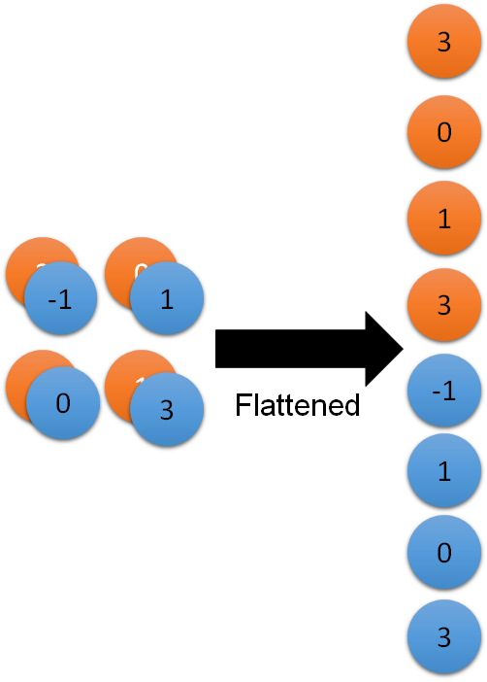

Flattening
Flattening converts last convolutional layer into 1-dimentional array
1-dimentional array is fed to a classification model (e.g., fully connected network) as input
Feature maps in the last convolutional layer
Class of Object
Fully Connected Feedforward Network

Slide 21


Pooling
Pooling is down sampling pixels which doesn't change the object
Pooling layers are used to reduce the dimensions of the feature maps. Thus, it reduces the number of parameters and the cost of computation in the network.
Pooling also avoid overfitting to noisy data by summarizing inputs
Larger bird image
Down Sampling
Smaller bird image

Slide 22
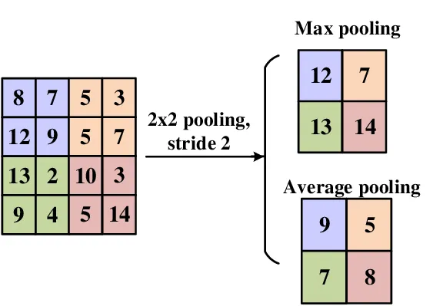
Pooling
The pooling operation summarizing the features lying within the region covered by the filter.
Max pooling calculates the maximum output and average pooling calculates average output within a defined neighborhood
Most popular type is max pooling since it better preserves detection of a pattern
Usually a 2 x 2 filter with a stride of 2

Slide 23
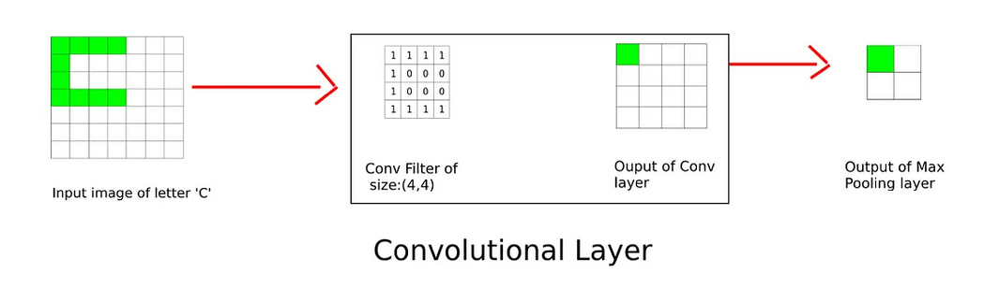
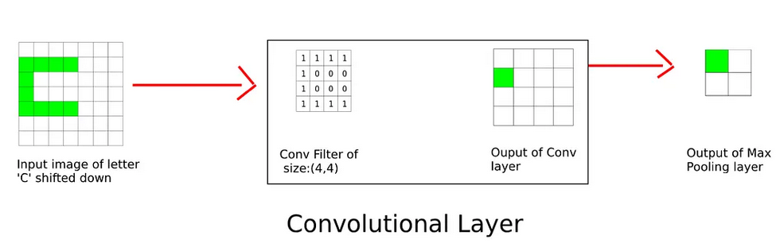
Translation Invariance
Pooling adds some translation invariance.
Translation invariance refers to a situation where a change in position of an object does not significantly affect the nature of the output. This makes the model more robust to variations in the position of the features in the input image
E.g., A beak is still a beak regardless of whether it appears in the top half or the bottom half of the image
2x2 Max Pooling

Slide 24
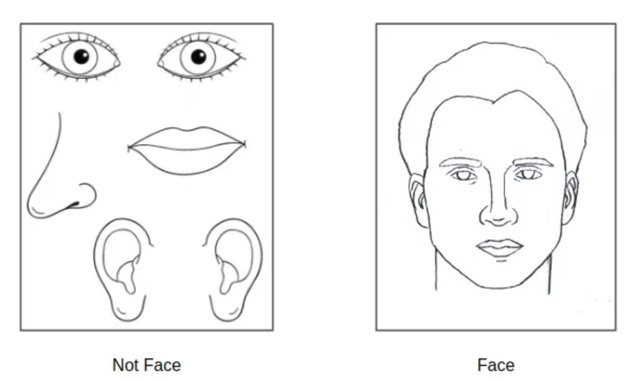
Translation Invariance - Drawback
The major issue with max pooling is that sometimes the network fails to learn the spatial relation between different features, and thus will give a false positive if all features are present in the wrong position with respect to one another.

Slide 25
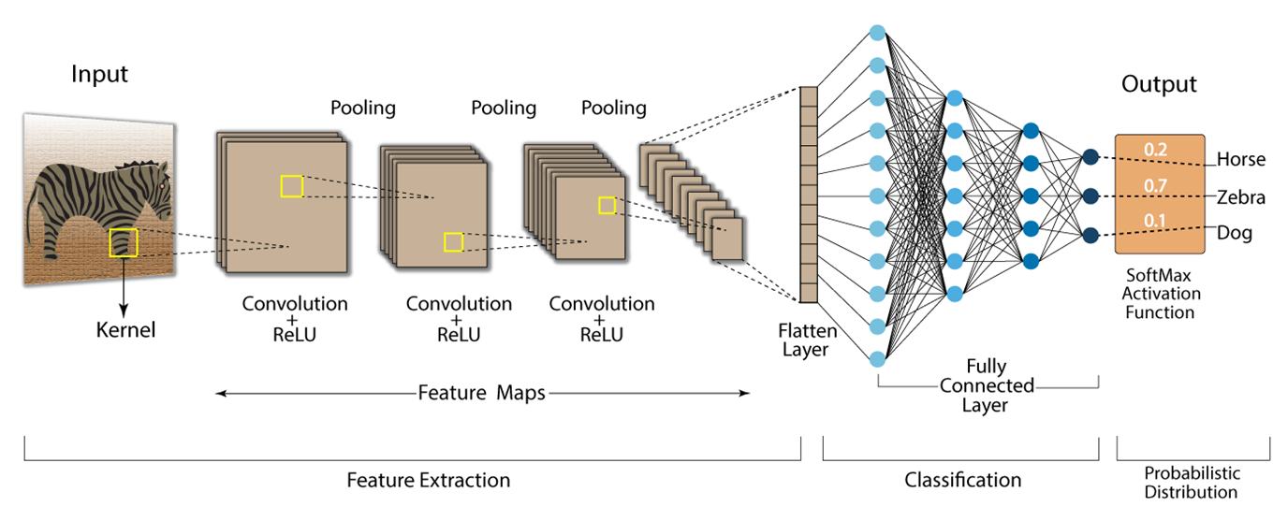
Typical CNN Architecture
First Stage: Pooling and convolutions can repeat inside CNNs:
Various filters (convolutions) detect Various features (in different levels)
Activation function (mostly ReLU) is used to deactivate non-pattern nodes (negative values) also to provide non-linearity
Pooling applies to reduce dimensions and add some translation invariance
Second Stage: Classification
Outputs of last convolutional layer is flattened
Fully connected layers handles classification process

Slide 26

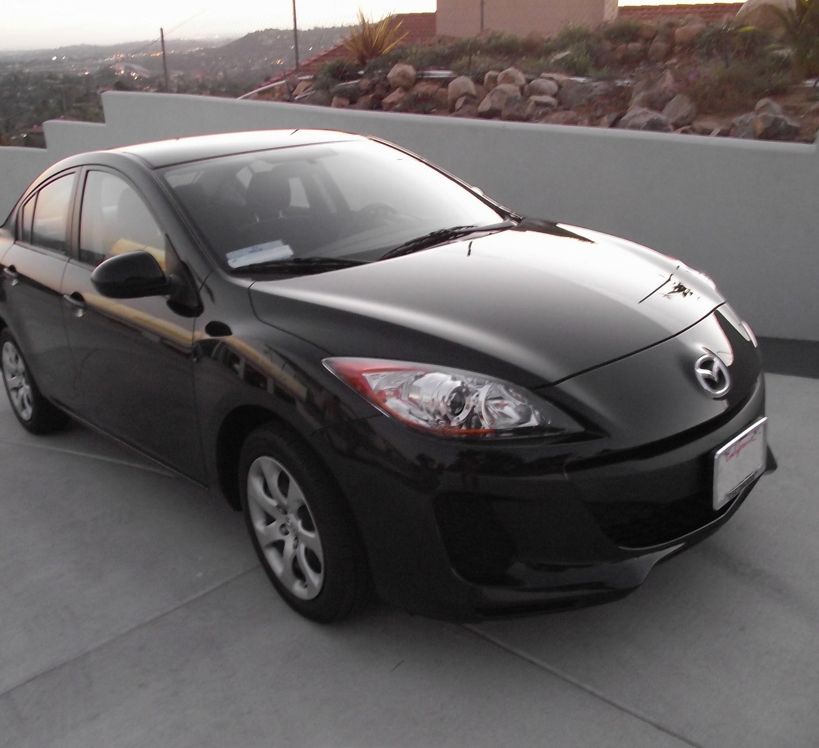
Typical CNN Architecture - Example

Slide 27
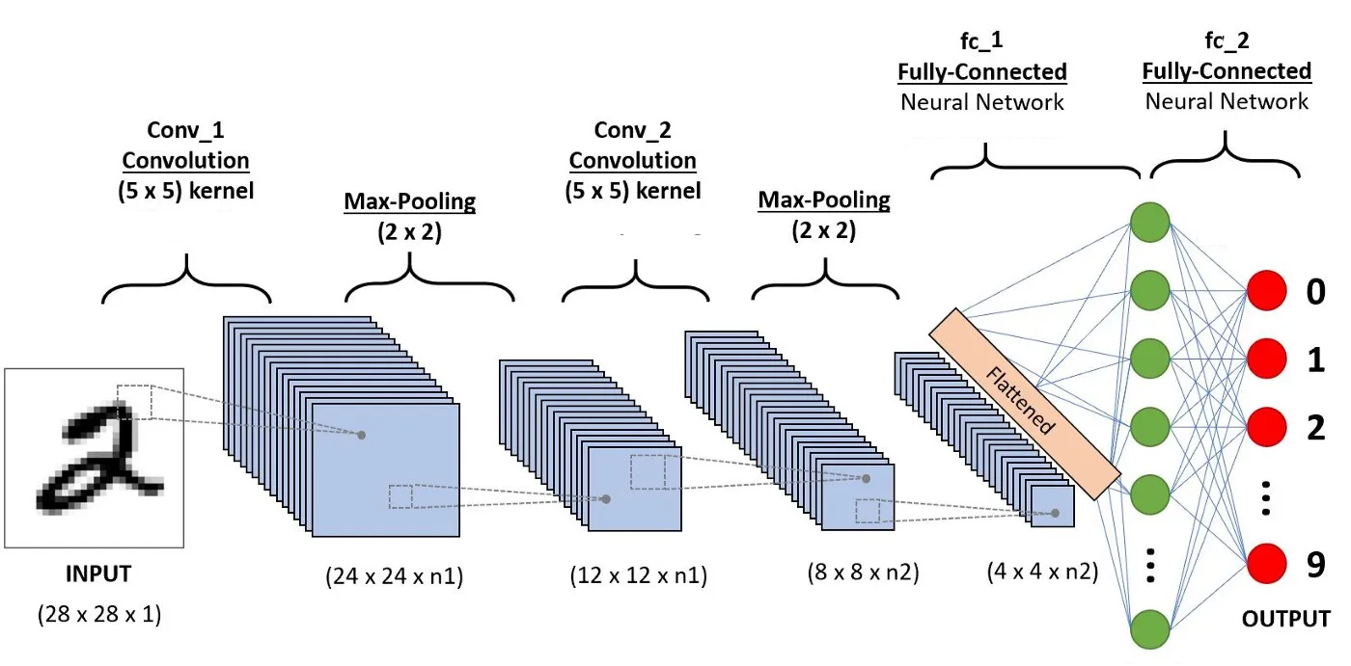
Parameters in CNN
10 class
a filter (kernel) of 5*5
Each 2*2 is represented by one (sampling)
28 x 28 pixels
1: black/white, 3: RGB
n1: number of filters in Conv_1
4*4*n2 neurons

Slide 28
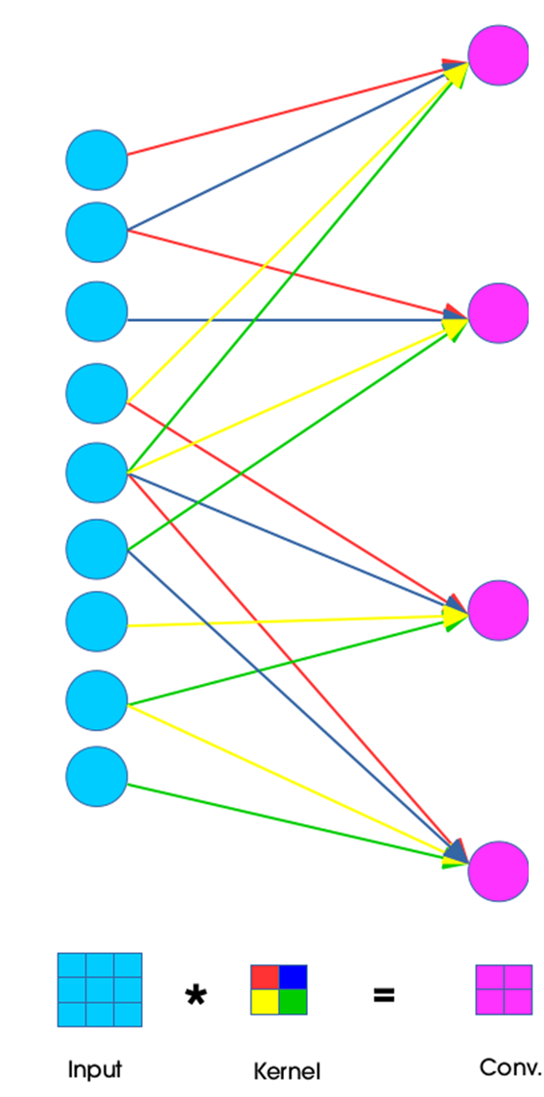
Parameters in Convolutional Layers
Filters (convolutions) are connections (weights) between different nodes in convolutional layers.
They are parameters adjusted during training

Slide 29
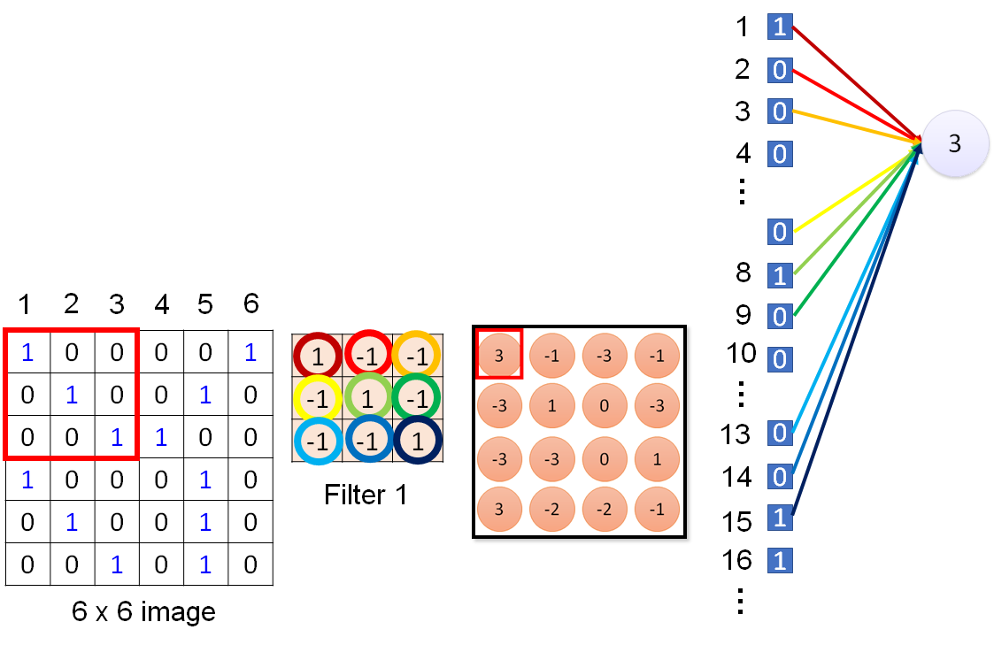
Parameters in Convolutional Layers
Each node needs to be connected to just a subset of nodes in last layer.
Therefore, fewer parameters comparing fully connected layers.
This makes training less computationally expensive
This node has 9 connections out of 36 possible connection

Slide 30
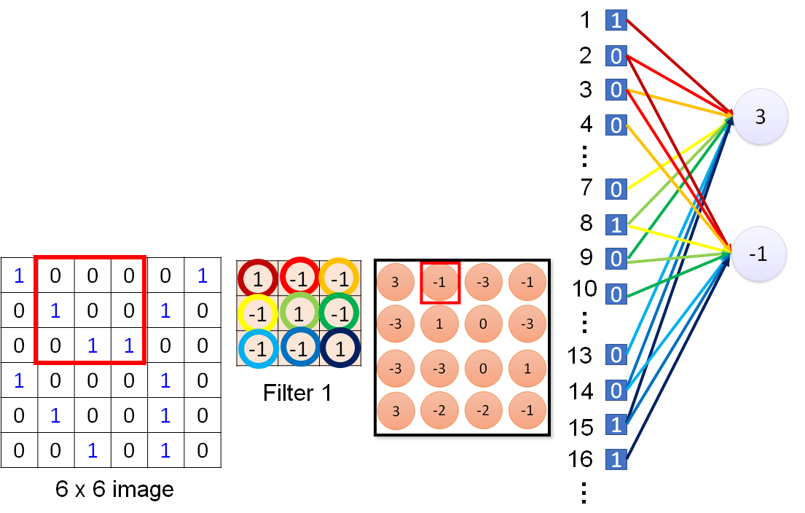
Parameters in Convolutional Layers – Shared Weights
Each filter represent weights shared between nodes
Results of learning by one of this weights can be used for the other ones, therefore, shared weights for a same filter needs less parameters to learn by the NN
Besides less connection and shared weights, max pooling also reduces dimensions in CNN
9 learnable parameters out of 6*6*4*4 possible parameters

Slide 31
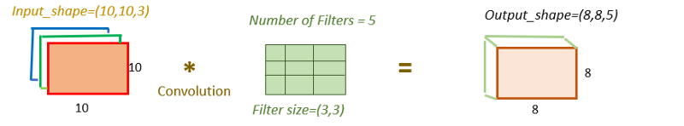
Number of Learnable Parameters
The pooling layers replace a neighborhood by its maximum/average value. So there is no learnable parameter
In a fully-connected layer, all input units have a separate weight to each output unit. so, the number of parameters: nodes in the first layer*nodes in the second layer
For convolutional layers, suppose that the input has l=3 feature maps as input, k=5 filters, and the filter size is n=3 x m=3. There are 5 different 3x3x3 filters, as input has 3 channels (feature maps). Thus, the total number of weights is n*m*k*l = 3*3*3*5
If there is also a bias, it will be added to parameters

Slide 32
Parameters in CNN- Example
Input
1 x 28 x 28
Parameters for each filter: 9
25 of 3*3 Filters
Convolution
25 * 9 parameters
25 x 26 x 26
2*2 Max Pooling
Max Pooling
25 x 13 x 13
Parameters for each filter: 225=25x9
50 of 3*3 Filters
Convolution
225 * 50 parameters
50 x 11 x 11
Fully Connected Feed Forward Network
2*2 Max Pooling
Max Pooling
50 x 5 x 5
1250=50*5*5
Flattened

Slide 33
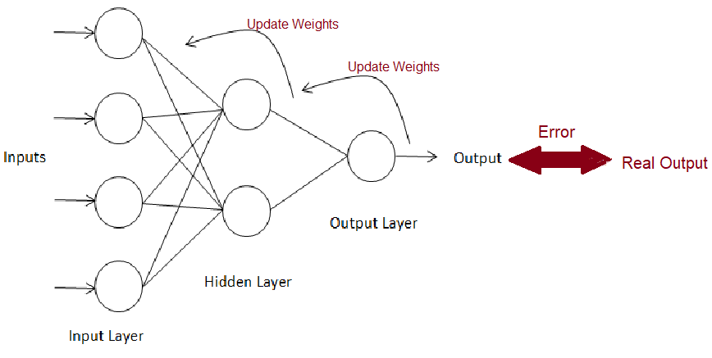
Training - Backward Propagation
The goal of backpropagation is to optimize the weights so that create output close to target outputs.
To optimize the output, we need to adjust corresponding weights also output from the last layer.
To adjust the output from last layer we need to adjust corresponding weights also output from the two last layer, and so on ….
So, the method that was suggested was to take the errors at the output layer and proportionally propagate them backwards to the hidden layer.
Gradient Decent can be used to adjust weights.

Slide 34
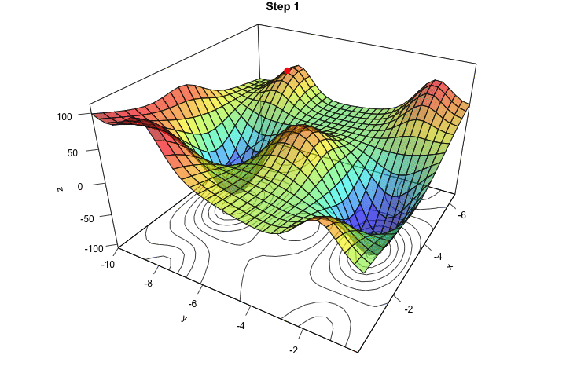
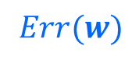

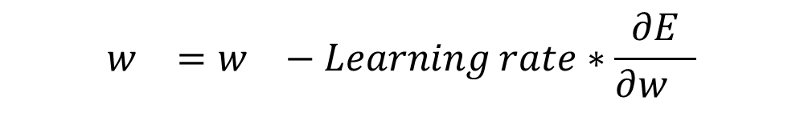
Gradient Descent
Gradient descent is a greedy iterative optimization algorithm that is used to approximate the optimized weights which minimize the loss function.
The goal is then to minimize the error by iteratively moving downwards using a step size (Learning Rate).
$$w_{}=w_{}−Learning rate∗\frac{∂E}{∂w_{}}$$

Slide 35
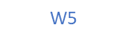
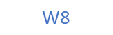
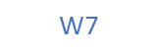
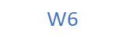
Training CNN
CNN is trained the same way as FNN using backpropagation with gradient descent
Forward Propagation:
Z1 = a1*w1 + a2*w2 + a4*w3 + a5*w4
Z2 = a2*w1 + a3*w2 + a5*w3 + a6*w4
Z3 = a4*w1 + a5*w2 + a7*w3 + a8*w4
Z4 = a5*w1 + a6*w2 + a8*w3 + a9*w4
$$Output\text{= }\text{Sigmoid}\text{(}\text{Z}\text{1∗}\text{w}\text{5 + }\text{Z}\text{2∗}\text{w}\text{6 + }\text{Z}\text{3∗}\text{w}\text{7 + }\text{Z}\text{4∗}\text{w}\text{8)}$$
Flatten
z1
z2
z3
z4
$$\text{W}\text{5}$$
a1 | a2 | a3
a4 | a5 | a6
a7 | a8 | a9
$$\text{W}\text{6}$$
W1 | W2
W3 | W4
z1 | z2
z3 | z4
Sigmoid
Output
$$\text{W}\text{7}$$
$$\text{W}\text{8}$$

Slide 36
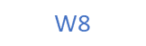
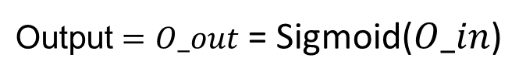
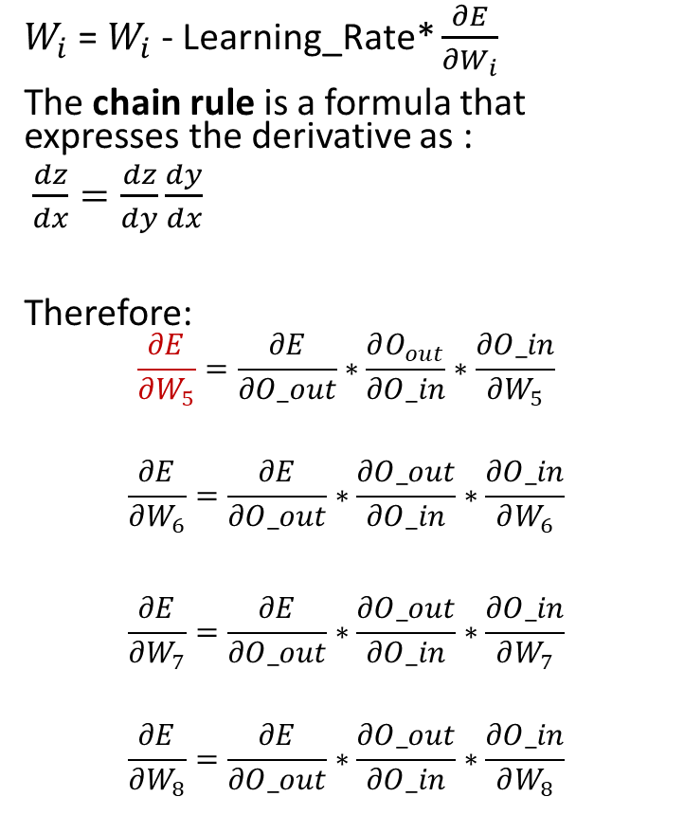
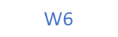
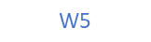
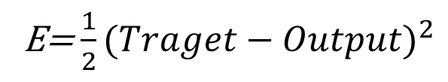
Training CNN – Backprop in Fully Connected Layers
$W_{i}$ = $W_{i}$ - Learning_Rate* $\frac{∂E}{∂W_{i}}$
The chain rule is a formula that expresses the derivative as :
$\frac{dz}{dx}=\frac{dz}{dy}\frac{dy}{dx}$
Therefore:
$$\frac{∂E}{∂W_{5}}=\frac{∂E}{∂O_out}∗\frac{∂O_{out}}{∂O_in}∗\frac{∂O_in}{∂W_{5}}$$
$$\frac{∂E}{∂W_{6}}=\frac{∂E}{∂O_out}∗\frac{∂O_out}{∂O_in}∗\frac{∂O_in}{∂W_{6}}$$
$$\frac{∂E}{∂W_{7}}=\frac{∂E}{∂O_out}∗\frac{∂O_out}{∂O_in}∗\frac{∂O_in}{∂W_{7}}$$
$$\frac{∂E}{∂W_{8}}=\frac{∂E}{∂O_out}∗\frac{∂O_out}{∂O_in}∗\frac{∂O_in}{∂W_{8}}$$
$$O_in\text{= }\text{Z}\text{1∗}\text{w}\text{5 + }\text{Z}\text{2∗}\text{w}\text{6 + }\text{Z}\text{3∗}\text{w}\text{7 + }\text{Z}\text{4∗}\text{w}\text{8}$$
$\text{Output}=O_out$ = Sigmoid($O_in$)
E=$\frac{1}{2}(Traget−Output)^{2}$
Real Label (Target)
z1
z2
z3
z4
Error (E)
$$\text{W}\text{5}$$
In out
$$\text{W}\text{6}$$
O
Output
$$\text{W}\text{7}$$
$$\text{W}\text{8}$$

Slide 37
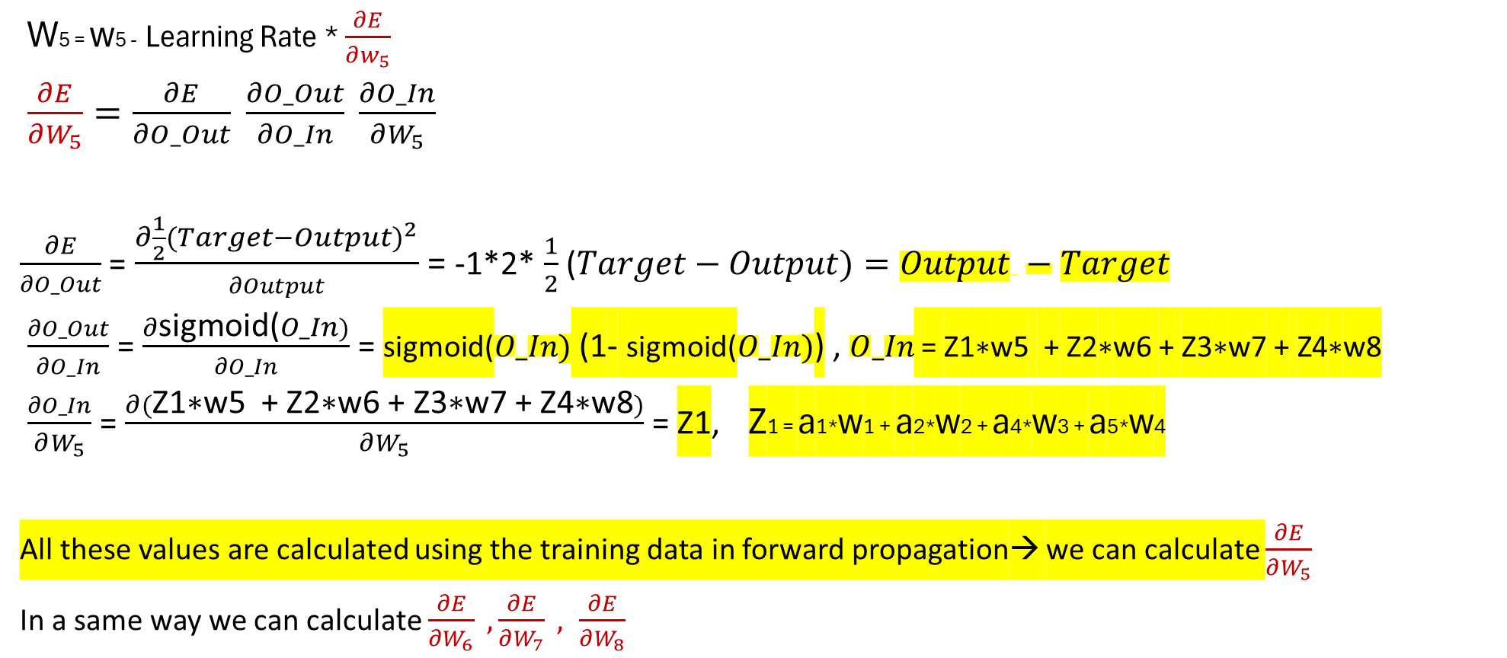
Training CNN – Backprop in Fully Connected Layers
Real Label (Target)
W5 = w5 - Learning Rate * $\frac{∂E}{∂w_{5}}$
$\frac{∂E}{∂W_{5}}=\frac{∂E}{∂O_Out} \frac{∂O_Out}{∂O_In} \frac{∂O_In}{∂W_{5}}$
$\frac{∂E}{∂O_Out}$ = $\frac{∂\frac{1}{2}(Target−Output)^{2}}{∂Output}$ = -1*2* $\frac{1}{2}$ ($Target−Output{)=Output −Target}^{}$
$\frac{∂O_Out}{∂O_In}$ = $\frac{∂\text{sigmoid}\text{(}O_In)}{∂O_In}$ = $\text{sigmoid}\text{(}O_In)$ (1- $\text{sigmoid}\text{(}O_In)$) , $O_In$ = $\text{Z}\text{1∗}\text{w}\text{5 + }\text{Z}\text{2∗}\text{w}\text{6 + }\text{Z}\text{3∗}\text{w}\text{7 + }\text{Z}\text{4∗}\text{w}\text{8}$
$\frac{∂O_In}{∂W_{5}}$ = $\frac{∂(\text{Z}\text{1∗}\text{w}\text{5 + }\text{Z}\text{2∗}\text{w}\text{6 + }\text{Z}\text{3∗}\text{w}\text{7 + }\text{Z}\text{4∗}\text{w}\text{8})}{∂W_{5}}$ = $\text{Z}\text{1}$, Z1 = a1*w1 + a2*w2 + a4*w3 + a5*w4
All these values are calculated using the training data in forward propagation→ we can calculate $\frac{∂E}{∂W_{5}}$
In a same way we can calculate $\frac{∂E}{∂W_{6}} ,\frac{∂E}{∂W_{7}} , \frac{∂E}{∂W_{8}}$
z1
z2
z3
z4
$$\text{W}\text{5}$$
Error (E)
In out
$$\text{W}\text{6}$$
O
Output
$$\text{W}\text{7}$$
$$\text{W}\text{8}$$

Slide 38
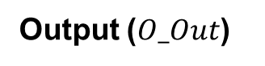
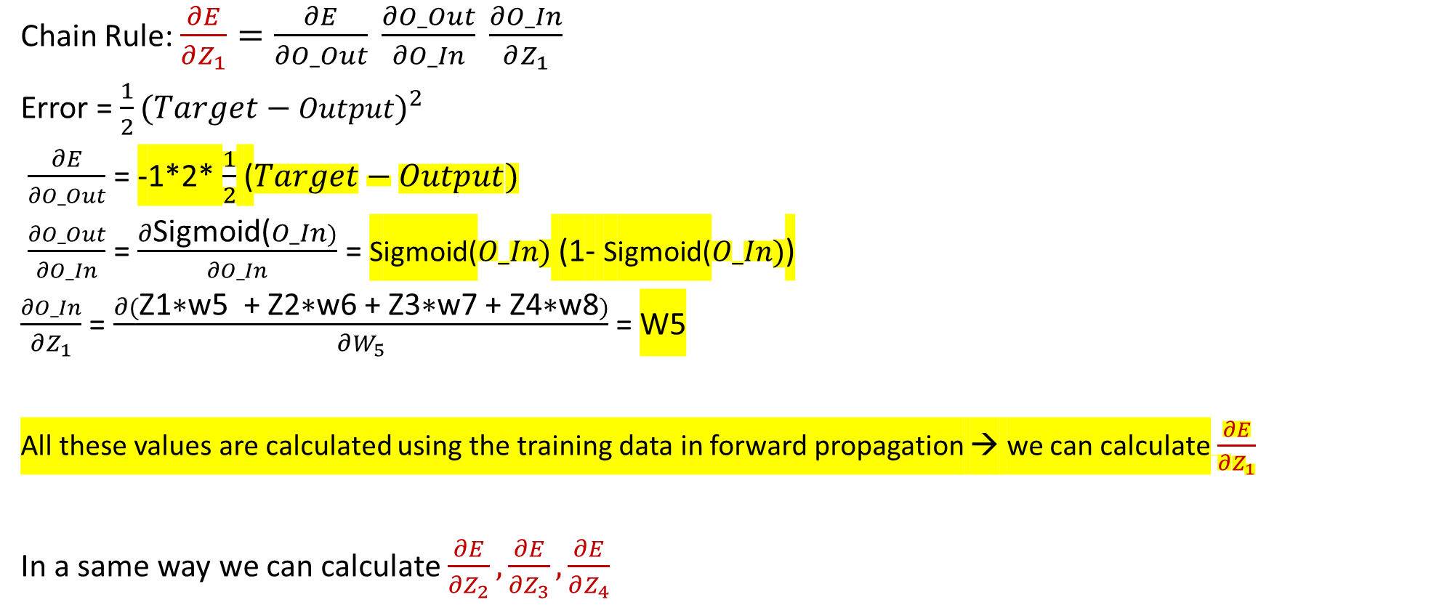
Training CNN – Backprop in Fully Connected Layers
Chain Rule: $\frac{∂E}{∂Z_{1}}=\frac{∂E}{∂O_Out} \frac{∂O_Out}{∂O_In} \frac{∂O_In}{∂Z_{1}}$
Error = $\frac{1}{2}(Target−Output)^{2}$
$\frac{∂E}{∂O_Out}$ = -1*2* $\frac{1}{2}$ ($Target−Output)^{}$
$\frac{∂O_Out}{∂O_In}$ = $\frac{∂\text{S}\text{igmoid}\text{(}O_In)}{∂O_In}$ = $\text{S}\text{igmoid}\text{(}O_In)$ (1- $\text{S}\text{igmoid}\text{(}O_In)$)
$\frac{∂O_In}{∂Z_{1}}$ = $\frac{∂(\text{Z}\text{1∗}\text{w}\text{5 + }\text{Z}\text{2}\text{∗}\text{w}\text{6 }\text{+} \text{Z}\text{3}\text{∗}\text{w}\text{7 + }\text{Z}\text{4}\text{∗}\text{w}\text{8})}{∂W_{5}}$ = $\text{W}\text{5}$
All these values are calculated using the training data in forward propagation → we can calculate$\frac{∂E}{∂Z_{1}}$
In a same way we can calculate $\frac{∂E}{∂Z_{2}},\frac{∂E}{∂Z_{3}},\frac{∂E}{∂Z_{4}}$
Real Label (Target)
z1
z2
z3
z4
Error (E)
$$\text{W}\text{5}$$
In
Out
$$\text{W}\text{6}$$
O
Output ($O_Out$)
$$\text{W}\text{7}$$
$$\text{W}\text{8}$$

Slide 39
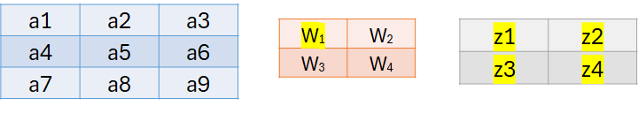
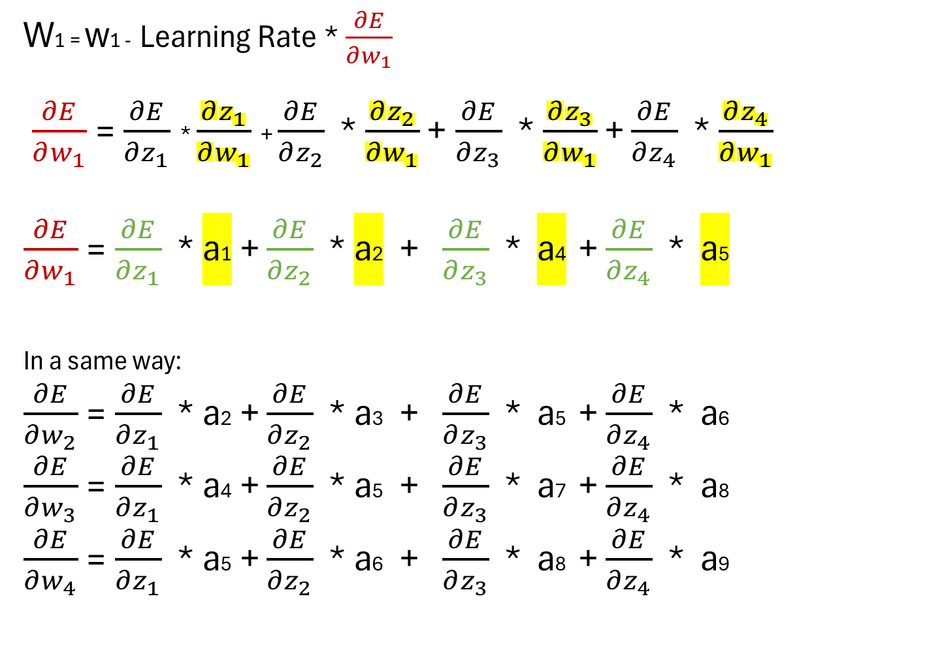
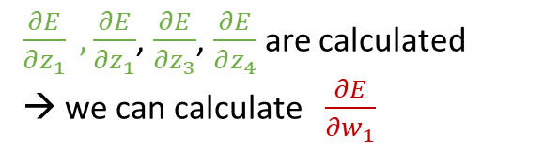
Training CNN – Backprop in Convolutional Layers
W1 = w1 - Learning Rate * $\frac{∂E}{∂w_{1}}$
$\frac{∂E}{∂w_{1}}$ = $\frac{∂E}{∂z_{1}}$ * $\frac{∂z_{1}}{∂w_{1}}$ + $\frac{∂E}{∂z_{2}}$ * $\frac{∂z_{2}}{∂w_{1}}$ + $\frac{∂E}{∂z_{3}}$ * $\frac{∂z_{3}}{∂w_{1}}$ + $\frac{∂E}{∂z_{4}}$ * $\frac{∂z_{4}}{∂w_{1}}$
$\frac{∂E}{∂w_{1}}$ = $\frac{∂E}{∂z_{1}}$ * a1 + $\frac{∂E}{∂z_{2}}$ * a2 + $\frac{∂E}{∂z_{3}}$ * a4 + $\frac{∂E}{∂z_{4}}$ * a5
In a same way:
$\frac{∂E}{∂w_{2}}$ = $\frac{∂E}{∂z_{1}}$ * a2 + $\frac{∂E}{∂z_{2}}$ * a3 + $\frac{∂E}{∂z_{3}}$ * a5 + $\frac{∂E}{∂z_{4}}$ * a6
$\frac{∂E}{∂w_{3}}$ = $\frac{∂E}{∂z_{1}}$ * a4 + $\frac{∂E}{∂z_{2}}$ * a5 + $\frac{∂E}{∂z_{3}}$ * a7 + $\frac{∂E}{∂z_{4}}$ * a8
$\frac{∂E}{∂w_{4}}$ = $\frac{∂E}{∂z_{1}}$ * a5 + $\frac{∂E}{∂z_{2}}$ * a6 + $\frac{∂E}{∂z_{3}}$ * a8 + $\frac{∂E}{∂z_{4}}$ * a9
Z1 = a1*w1 + a2*w2 + a4*w3 + a5*w4
Z2 = a2*w1 + a3*w2 + a5*w3 + a6*w4
Z3 = a4*w1 + a5*w2 + a7*w3 + a8*w4
Z4 = a5*w1 + a6*w2 + a8*w3 + a9*w4
$\frac{∂E}{∂z_{1}} ,\frac{∂E}{∂z_{1}}$, $\frac{∂E}{∂z_{3}}$, $\frac{∂E}{∂z_{4}}$ are calculated
→ we can calculate $\frac{∂E}{∂w_{1}}$
Instead of 9*4 parameters in a fully connected layer, it needs to learn only
4 parameters (w1,w2,w3,w4) in this convolutional layer.

Slide 40
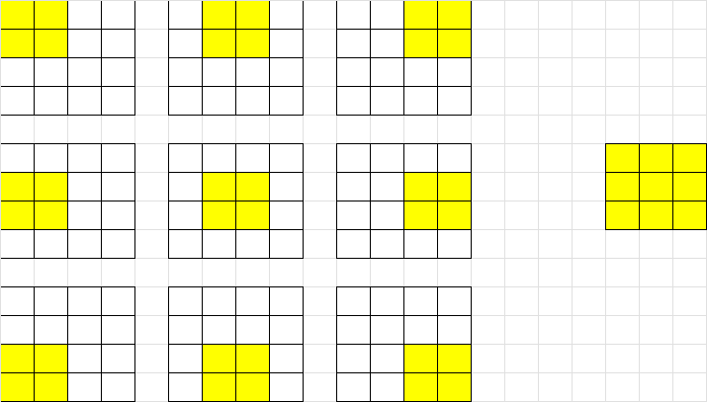

Stride
Stride is number of nodes, that the kernel moves over the input layer (vertically and horizontally)
A larger stride yields a smaller output (feature map).
Usually stride of one or two is used in CNN.
Output size= ((N - F) / stride) + 1
N*N
F*F
N = 4, F = 2, Stride 1
((4 - 2)/1) + 1 = 3
N = 4, F = 2, Stride 2
((4 - 2)/2) + 1 = 2

Slide 41

Padding
Sometimes stride doesn’t fit the input layer
We can pad input in every direction with 0’s before applying filter
0 | 0 | 0 | 0 | 0 | 0 | 0 | 0 | 0
0 |  |  |  |  |  |  |  | 0
0 |  |  |  |  |  |  |  | 0
0 |  |  |  |  |  |  |  | 0
0 |  |  |  |  |  |  |  | 0
0 |  |  |  |  |  |  |  | 0
0 |  |  |  |  |  |  |  | 0
0 |  |  |  |  |  |  |  | 0
0 | 0 | 0 | 0 | 0 | 0 | 0 | 0 | 0
3*3 filter on 7x7 input with stride 3

Slide 42

Padding
By applying a 3x3 filter to 6x6 image two times, we get a 2x2 image. Size of the image has gone down
Sometimes shrinking too fast is not desirable in feature maps.
If we want to keep image size the same, we can use padding
Same padding is common to preserve size spatially

Slide 43


Padding Types
Zero-padding is usually used when the filters do not fit the input image. This sets all elements that fall outside of the input matrix to zero, producing a larger or equally sized output. There are different types of padding:
Same padding: This padding ensures that the output layer has the same size as the input layer. Zero-padding with (F-1)/2 will preserve size spatially (filters of size FxF)
Full padding: This type of padding increases the size of the output by adding zeros to the border of the input.

Slide 44

Color Images – Filters
For RGB color images, each image is represented by three channels
Also, each filter should cover triple channels
1 | -1 | -1
-1 | 1 | -1
-1 | -1 | 1
1 | -1 | -1
-1 | 1 | -1
-1 | -1 | 1
Color image
1 | -1 | -1
-1 | 1 | -1
-1 | -1 | 1
Filter
1 | 0 | 0 | 0 | 0 | 1
0 | 1 | 0 | 0 | 1 | 0
0 | 0 | 1 | 1 | 0 | 0
1 | 0 | 0 | 0 | 1 | 0
0 | 1 | 0 | 0 | 1 | 0
0 | 0 | 1 | 0 | 1 | 0
1 | 0 | 0 | 0 | 0 | 1
0 | 1 | 0 | 0 | 1 | 0
0 | 0 | 1 | 1 | 0 | 0
1 | 0 | 0 | 0 | 1 | 0
0 | 1 | 0 | 0 | 1 | 0
0 | 0 | 1 | 0 | 1 | 0
1 | 0 | 0 | 0 | 0 | 1
0 | 1 | 0 | 0 | 1 | 0
0 | 0 | 1 | 1 | 0 | 0
1 | 0 | 0 | 0 | 1 | 0
0 | 1 | 0 | 0 | 1 | 0
0 | 0 | 1 | 0 | 1 | 0

Slide 45


Color Images - Output
A filter contains different weights for different channels
The results of convolution operations summed in the output layer

Slide 46

3D Images
A 3D Convolution is a type of convolution where the kernel slides in 3 dimensions as opposed to 2 dimensions with 2D convolutions.

Slide 47
Avoid Overfitting
Deep NNs have many hidden layers making them very expressive to learn complicated relationships between inputs and outputs.
With limited training data, many complicated relationships and overfitting to training data will be the result of training data noises.
• Many methods developed to reduce overfitting, including:
– Early stopping if accuracy is not increased on the validation data
– Dropout
– Data Augmentation

Slide 48

Dropout
In overfitting, some neurons may change in a way that address a few noises in the training data.
By randomly dropping a few neurons temporary during each epoch of training, it forces the other neurons to be more general for the inputs.
This approach ensures that the model is getting generalized and hence reducing the overfitting problem.
Dropout is just used during training the model, for test / production phases the complete neural network is used.

Slide 49


Dropout Method
Remove non-output units from base network.
randomly creates sub-models using masks (dropout layers).
Probability of including a unit is a hyperparameter (e.g.,0.5 for the hidden layer)

Slide 50

Dropout Result
Generally, use a small dropout value of 20%-50% of neurons.
Get better performance when Dropout is used on a larger network.
Dropout can be used on input layer as well as hidden layers.
Application of Dropout at each layer of the network has shown good results.
Dropout of 50% for hidden units and 20% for input units

Slide 51

Data Augmentation
Data augmentation is the process of artificially generating new data from existing data, primarily to train new machine learning (ML) models.
Augmenting a dataset of images includes adding noise to them, scaling, or cropping them, flipping image vertically and horizontally, shifting, adjusting brightness, contrast degree, or saturation, etc.
Generative adversarial networks (GAN) also can be used for Data augmentation
During the augmentation process, same labels corresponding to the source data are used for the synthetic data.
Data augmentation increases the dataset to reduce overfitting
Train a CNN on large shifted / flipped images make it more translation invariant.

Slide 52

CNN Architectures - LeNet5
(1) stacking convolutions and pooling layers
(2) ending the network with one or more fully-connected layers

Slide 53

CNN Architectures - LeNet5
Activation function is Softmax in output layer and Tanh in other layers
Filters of size 5X5 and stride is 1
5 layers with learnable parameters.
The input to the model is a grayscale image.
It has 3 convolution layers, two average pooling layers, and two fully connected layers.
The number of trainable parameters is 60000.

Slide 54

CNN Architectures - AlexNet
(1) deeper and with more filters than LeNet
(2) employed stacked convolutional layers
(3) was first to implement Rectified Linear Units (ReLUs) as activation functions

Slide 55

CNN Architectures - VGG-19
(1) significantly deeper network that the previous ones (16 to 19 layers)
(2) more and smaller filters (3x3)

Slide 56

CNN Architectures – Inception v1
(1) even deeper network (22 layers)
(2) implemented the inception module to drastically reduce the number of parameters
(3) trend towards smaller filters and deeper architectures

Slide 57

Accuracy

Slide 58


Computations vs Accuracy
Circle size is proportional to the number of parameters in the network

Slide 59

CPU GPU
Performance Considerations
Faster clock speed but fewer cores
Versatile instruction set
Complex logic control
Contains thousands of cores, allowing for parallel computing
Smaller instruction set (for a few specific tasks)
A neural network made from layer upon layer of linear algebra equations.
A deep neural network contains millions of parameters required huge computation power.
GPUs pack thousands of cores, tiny calculators working in parallel to slice through the math that makes up a Neural Network model.

Slide 60

Limitation of CNN
The cybersecurity firm McAfee showed that Mobileye, the car intelligence system used by Tesla and other auto manufacturers, could be fooled into accelerating 50 MPH over the speed limit just by plastering a strip of black tape two inches wide to a speed limit sign.
Researchers from four universities including the University of Washington and UC Berkeley discovered that road sign recognition models were completely fooled when introduced to a bit of spray paint or stickers on stop signs, all completely natural and non-malicious alterations

Slide 61


Limitation of CNN
Traditional CNNs are bad at generalizing across scaling, shifts and rotations in images, as well as different angles of three-dimensional viewing.
Data augmentation and training with images from various angles improve the results.

